Slide 1

Cloud Whisper
The ultimate cloud assistant
Team Members :
Ansh Malik (MAIT)
Arnav Bhatia (MAIT)
Sanket Singh Negi (GTBIT)

Slide 2
Problem Statement
❓
High technical barriers
Lack of such cloud assistants
No intelligence abstraction
Limited accessibility

Slide 3

Project Objective
The goal of our project is to develop an intelligent NLP driven platform that allows users to perform cloud operations with much ease.
Key Objectives
Minimising tech barriers
Rapid execution
Leveraging LLMs

Slide 4







Tech Stack
Frontend : Streamlit
Lightweight python framework
Allowed fast deployment
Less use of code
CloudPlatform : acecloud
Offers GPUs like NVIDIA A100
Provides Load Balancers
Private Cloud Service
Code Editor :VS CODE
Provides support to various languages
Lightweight fast code editor
Infrastructure: Openstack SDK
It is a python SDK used to interact with cloud platform
Provides services like nova, cinder etc
Allows creation and management of VMs, disks, networks.
Code Language : Python
Versatile Language
Supports Openstack SDK
Can interact with LLMs
Can be further used to make FAST APIs.
Database : SQL/CSV Files
Currently all the operations are stored in CSV file format.
SQL connector can be used to use MySQL DB.

Slide 5
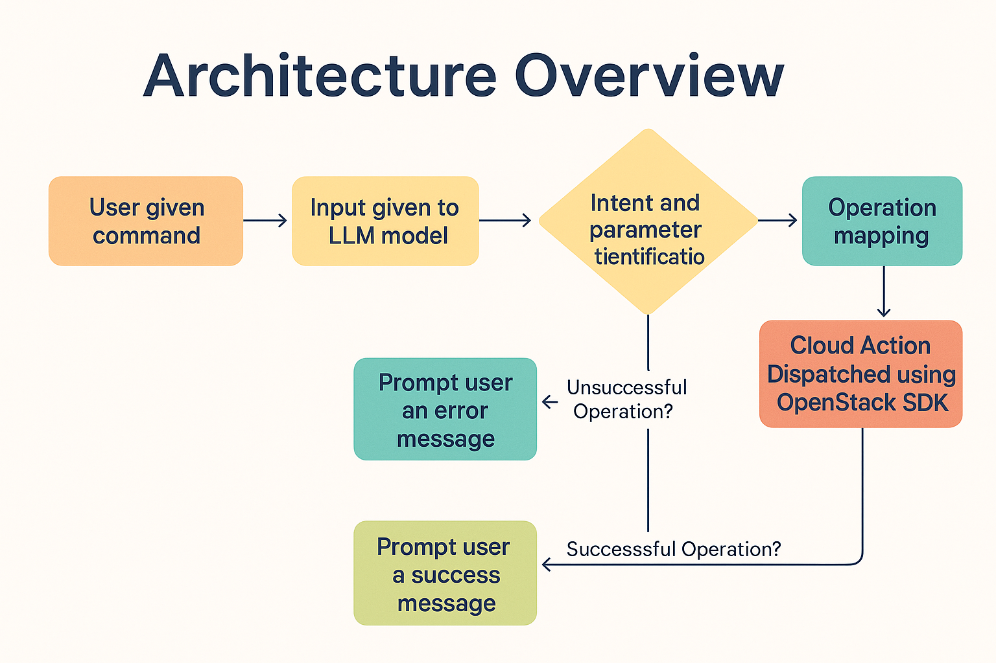
Architecture Overview
Intent and parameter identification
User given command
Input given to LLM model
Operation mapping
identification
Cloud Action Dispatched using Openstack SDK
Prompt user an error message
Unsuccessful Operation?
Prompt user a success message
Successful Operation?

Slide 6
Example Commands
Create a private network named <private network name>
Create an S.4 VM named <name>
Create a <size(eg : 10GB)> volume named <volume name>
Delete the volume named as <volume name>

Slide 7
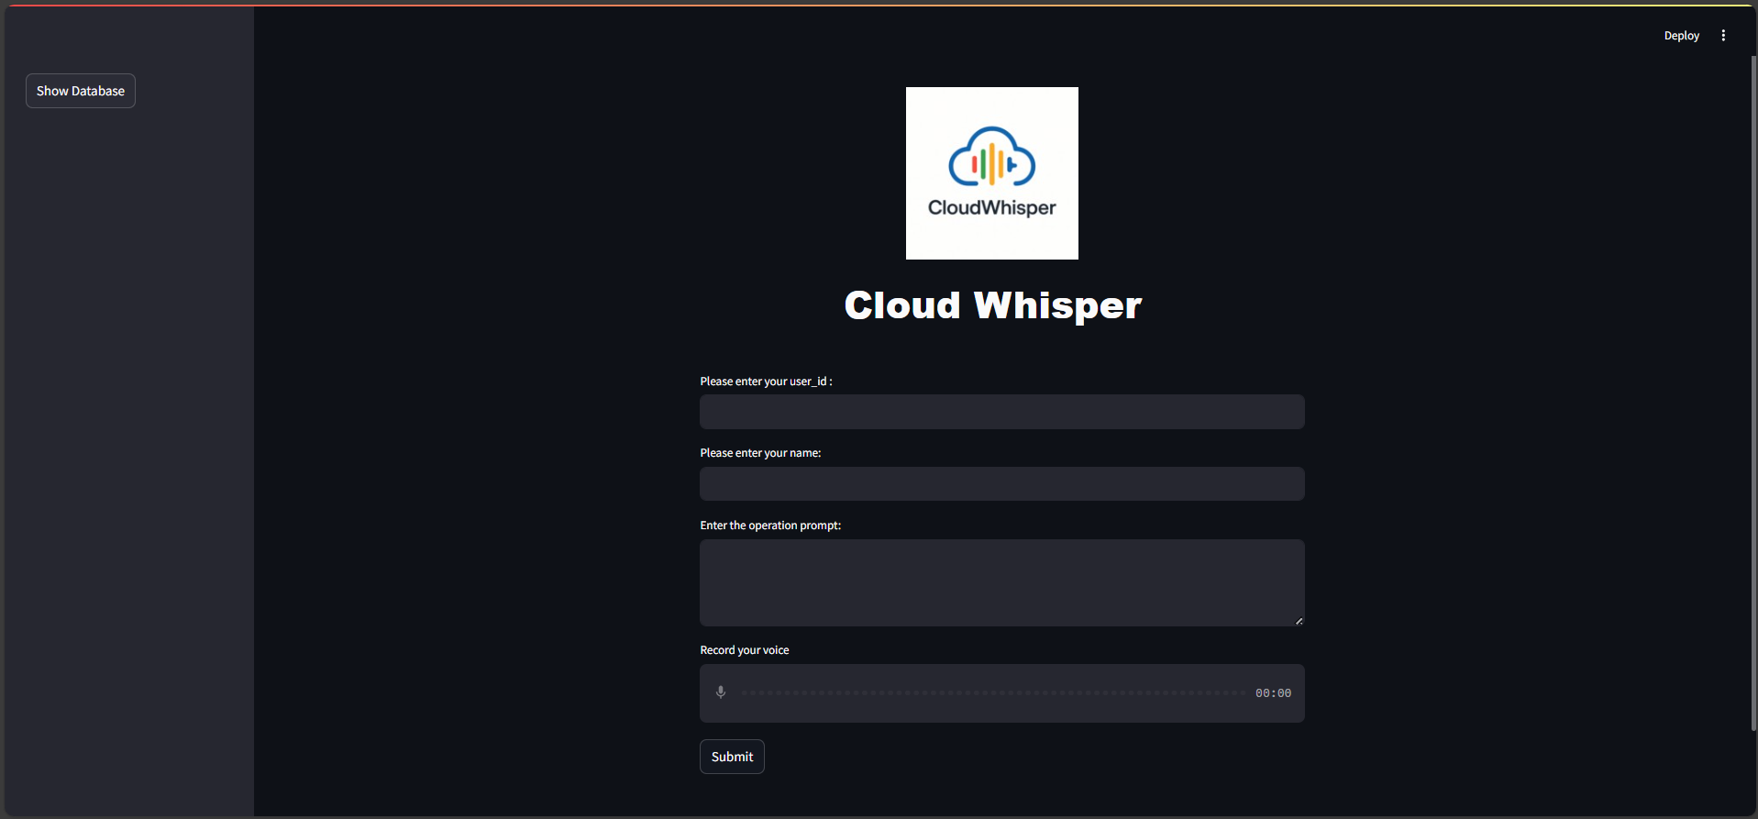
Snippet of the WebApp

Slide 8
Designing for Clarity and Simplicity
Real time feedback for each command
Colour coded success and error messages
Database to store all the operations
Efficient feature extraction and intent detection

Slide 9

Challenges Faced During Development
Extracting accurate details from user’s input
OpenStack errors and debugging
Time Constraint
Lack of Direct LLM-to-SDK Documentation

Slide 10

Future Scope
Multi Cloud Support
Better LLMs
Voice Based Commands
Role Based Access
Undo Operations
Full Stack Website

Slide 11
Conclusion
CloudWhisper represents a transformative step in cloud computing — turning complex infrastructure management into a simple, conversational experience. By combining the power of LLMs with the flexibility of OpenStack and the usability of Streamlit, we’ve built a system that makes cloud operations accessible to everyone, not just DevOps experts. This project showcases how AI can bridge the gap between human intent and technical execution, laying the foundation for a future where managing the cloud is as easy as having a conversation.

